Slide 1

Recognise and Promote Ways to Support Healthy Functioning of the Body
CHCCCS041 - Recognise healthy body systems (Release 1)

Slide 2



This chapter will focus on ways to keep the body healthy by recognising and promoting activities that encourage healthy habits to maintain the body in its best shape.
There are generally two types of maintenance care that you can consider in helping your clients keep being fit and healthy:
Preventive Care
Diagnostic Care
Recognise and Promote Ways to Support Healthy Functioning of the Body

Slide 3

2.1
Review Factors for Healthy Body Maintenance

Slide 4
There are different factors that contribute to the overall health of a person’s body.
To decrease the risk of developing certain conditions such as heart diseases, some cancers, and injuries, you must consider the following factors that impact the maintenance of a healthy body.
Nutrition
Movement
Social interaction
Hydration
Skin integrity
Recognise and Promote Ways to Support Healthy Functioning of the Body

Slide 5
The abovementioned factors are also the areas of life that you must monitor to promote the overall health of your clients.
Below describes each area of life mentioned:
Nutrition - eating the right amount and right kind of food
Hydration - drinking enough fluids
Skin integrity - overall health or function of your skin
Recognise and Promote Ways to Support Healthy Functioning of the Body

Slide 6

Below describes each area of life mentioned:
Movement - the ability of the body to move various body parts as part of a whole mechanism
Social interaction - ability to interact with the people around
Recognise and Promote Ways to Support Healthy Functioning of the Body

Slide 7

How these areas contribute to the maintenance of a healthy body can be seen in the way these areas interact with each other and how it affects older people and people with disability.
Recognise and Promote Ways to Support Healthy Functioning of the Body

Slide 8
Nutrition and Hydration
Certain conditions associated with ageing or some disabilities require specific dietary restrictions, affecting the client’s nutrition and hydration. Below are ways to promote your client’s health and well-being in terms of hydration:
Aim to drink at least six times a day (more during warmer weather or after exercising)
Avoid drinking caffeinated drinks and alcohol, as they can dehydrate
Eat water-rich foods (e.g. cucumber, tomato, spinach, etc.)
Recognise and Promote Ways to Support Healthy Functioning of the Body

Slide 9
Nutrition and Hygiene
Not having proper, clean hygiene can make the client sick, which can limit their ability to consume food and fluids. Remember that hygiene is not limited to the cleanliness of one’s body. There are different classifications of hygiene. They are as follows:
Personal hygiene
Environmental hygiene
Domestic hygiene
Food hygiene
Recognise and Promote Ways to Support Healthy Functioning of the Body

Slide 10
Consequences of Poor Oral Hygiene on Nutrition
Poor oral health can lead to impaired oral health, e.g. missing teeth (due to tooth decay and dental cavities) and gum diseases.
Impaired oral health can affect the client’s ability to chew or swallow food. This can negatively impact their nutritional intake.
They may consume fewer meals or meals with lower nutritional value, which can lead to poor nutritional status and an increased risk of malnutrition.
Recognise and Promote Ways to Support Healthy Functioning of the Body

Slide 11
Impact of Poor Oral Hygiene on Quality of Life
Quality of life refers to the client’s satisfaction and general positive view of their status.
When the person experiences pain and other effects of poor oral hygiene, it hinders them from enjoying good quality of life.
Recognise and Promote Ways to Support Healthy Functioning of the Body

Slide 12
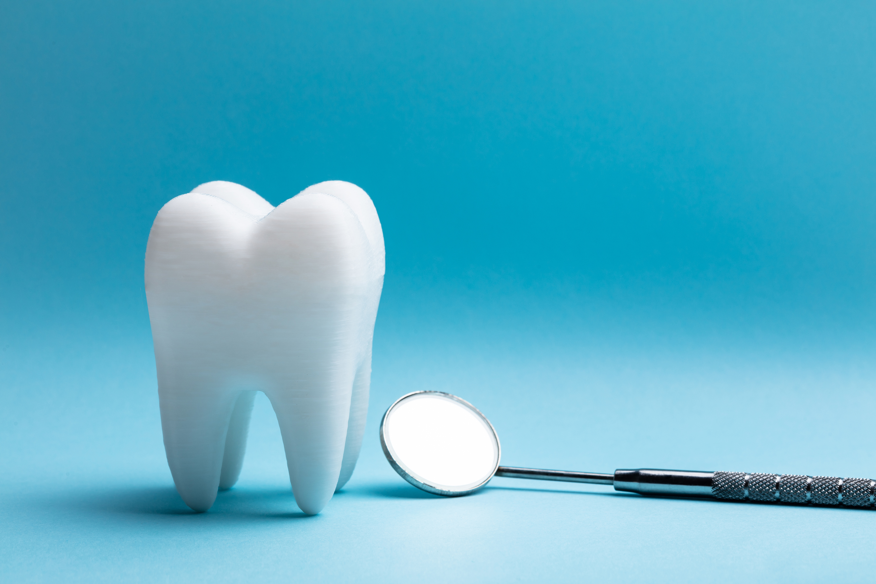
Tooth decay, missing teeth, foul breath, bleeding gums and oral pain are all physical effects of poor oral hygiene. These lead to more serious problems such as:
Oral infection
Trouble swallowing and eating the food
Difficulty consuming liquid
Decrease in appetite
Recognise and Promote Ways to Support Healthy Functioning of the Body

Slide 13
Having poor nutritional intake leads to more serious problems such as, but not limited to:
Weakened body
Stress
Easily getting sick
Loss of energy to carry out daily tasks
Recognise and Promote Ways to Support Healthy Functioning of the Body

Slide 14
Recognising Signs of Oral Pain
If you notice any of the signs below, check your client’s condition and coordinate immediately with a health professional, specifically a dentist, to address the concern.
Small food and hydration intake than normal
Trouble speaking
Trouble opening the mouth
Trouble chewing
Blood in the mouth or saliva
Recognise and Promote Ways to Support Healthy Functioning of the Body

Slide 15
Recognising Signs of Oral Pain
If you notice any of the signs below, check your client’s condition and coordinate immediately with a health professional, specifically a dentist, to address the concern.
Dry mouth
Foul-smelling breath
Gum swelling which may be noticeable when you look at the cheek
Gum discoloration
Recognise and Promote Ways to Support Healthy Functioning of the Body

Slide 16
Exercise and Movement
The presence of ageing-related changes, conditions and illnesses can limit the older adult’s exercise and movement.
The decline of their health, including vision and bone health, e.g. joints becoming stiffer and less flexible, can make exercise and movement difficult.
At the same time, people who have disabilities may find it more difficult to do regular exercise and movement.
Recognise and Promote Ways to Support Healthy Functioning of the Body

Slide 17

People who have illnesses and other conditions may also experience barriers and restrictions to daily life more frequently.
Due to these restrictions, people are likely to do less exercise and movement. Not getting enough physical activities can lead to serious issues (i.e. heart disease, increased risk factors for obesity, high blood pressure, cholesterol, type 2 diabetes)
Recognise and Promote Ways to Support Healthy Functioning of the Body

Slide 18
The table below lists the resources you can review and what you can learn from reviewing these resources:
Area | Resources to review | What you can learn
Nutrition | Nutrition assessments, food diary, etc. | Understand your client’s nutrition status and eating habits. Discover food allergies.
Hydration | Vital signs, fluid balance chart, daily weight chart, fluid prescription chart, and surgical documentation | Understand whether your client is dehydrated or well-hydrated.
Recognise and Promote Ways to Support Healthy Functioning of the Body

Slide 19
The table below lists the resources you can review and what you can learn from reviewing these resources:
Area | Resources to review | What you can learn
Skin integrity | Pressure ulcers clinical data collection form or other similar documents | Check the client’s skin for any cracks, openings, bruises, rashes, and lesions.
Movement | Physical therapy assessment documentation and medical history | Assure the current state of your client's ability and capacity to move.
Recognise and Promote Ways to Support Healthy Functioning of the Body

Slide 20
The table below lists the resources you can review and what you can learn from reviewing these resources:
Area | Resources to review | What you can learn
Social interaction | Psychological reports, geriatric functional assessment documentation, etc. | Clarify your client’s psychological state to check for neglect or trauma.
Recognise and Promote Ways to Support Healthy Functioning of the Body

Slide 21
Below are ways how to promote and maintain your client’s health relevant to the following areas:
Area | Ways of promoting and maintaining health and wellbeing
Nutrition | Follow healthy eating habits. Take vitamins and minerals as recommended Eat a wide variety of foods from the five food groups.
Hydration | Aim to drink at least six times a day Avoid drinking caffeinated drinks and alcohol Eat water-rich foods, e.g. cucumber, spinach, etc.
Recognise and Promote Ways to Support Healthy Functioning of the Body

Slide 22
Below are ways how to promote and maintain your client’s health relevant to the following areas:
Area | Ways of promoting and maintaining health and wellbeing
Skin integrity | Ensuring skin is cleansed, dried thoroughly, and moisturised daily. Use pressure redistributing seating cushions for people with limited mobility to reduce prolonged exposure to pressure. Using non-soap cleansers with a pH close to 5.5
Recognise and Promote Ways to Support Healthy Functioning of the Body

Slide 23
Below are ways how to promote and maintain your client’s health relevant to the following areas:
Area | Ways of promoting and maintaining health and wellbeing
Movement | Encourage incidental activities or physical activities that occur as part of the person’s regular daily activities, e.g. walking to the toilet, dressing, eating meals out of bed, etc. Follow an exercise program recommended by the doctor that includes strength, balance, and aerobic exercises.
Recognise and Promote Ways to Support Healthy Functioning of the Body

Slide 24
Below are ways how to promote and maintain your client’s health relevant to the following areas:
Area | Ways of promoting and maintaining health and wellbeing
Social interaction | Incorporate social interaction into activities, e.g. running group exercise activities. Plan regular visits with family/grandchildren Join communities, hobby or interest groups, e.g. book club, volunteering at an animal shelter, etc.
Recognise and Promote Ways to Support Healthy Functioning of the Body

Slide 25

Programs to Support Client’s Health
There are many ways to implement the abovementioned in the client’s routine or treatment plan.
In fact, there are already initiatives and programs the government has put in place for older people and people with disability.
Recognise and Promote Ways to Support Healthy Functioning of the Body

Slide 26
Some of these programs and initiatives include:
Initiative or program | Description
Advance Care Planning Australia | It is a national program promoting advance care planning, involving resources and national curriculum and learning.
Commonwealth Home Support Programme (CHSP) | It provides basic support for older people who need some help to stay at home. Service providers work with them to maintain their independence and keep them as well as possible.
Recognise and Promote Ways to Support Healthy Functioning of the Body

Slide 27
Some of these programs and initiatives include:
Initiative or program | Description
Dementia, Ageing and Aged Care Mission | It supports older people to maintain health and quality of life as they age. They also aim for each older person to live independently for longer and access quality care when they need it.
Recognise and Promote Ways to Support Healthy Functioning of the Body

Slide 28

2.2
Evaluate How Body Systems Affect Health Functioning

Slide 29
As a support worker, it is your job to maintain the health of your client.
However, apart from you, there is also one that works twice as hard in keeping your client’s body healthy and functioning.
This is none other than their body itself.
In addition to the amazing structure and function of the human body’s organ systems, the body can also regulate itself to maintain a stable internal environment despite the changes it experiences in the external environment.
Recognise and Promote Ways to Support Healthy Functioning of the Body

Slide 30
2.2.1 Body Regulation
Below are the various ways the body regulates itself and the body systems mainly responsible for each role in keeping the body in good shape:
Temperature
Fluid and electrolyte balance
PH levels
Blood pressure
Recognise and Promote Ways to Support Healthy Functioning of the Body

Slide 31
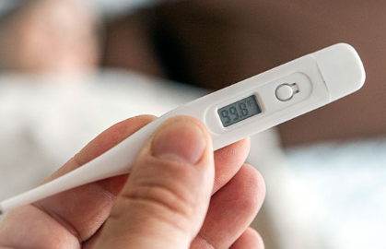
Temperature
The body’s temperature must be maintained at an ideal range, or close to the core body temperature of 37°C for the body to function properly.
Recognise and Promote Ways to Support Healthy Functioning of the Body

Slide 32
Below are some of the responses of the body due to changes in temperature:
Skin hairs trap more warm air if they are standing up and less if they lie flat.
Sweating is one of the primary methods your body uses to maintain its temperature.
Blood vessels supplying blood to the capillaries in the skin can widen, which decreases blood pressure.
Blood vessels can narrow or constrict which increases blood pressure.
Recognise and Promote Ways to Support Healthy Functioning of the Body

Slide 33
A condition that can affect the proper regulation of body temperature includes Anhidrosis.
It is the inability to sweat normally which occurs when sweat glands don’t function properly.
Recognise and Promote Ways to Support Healthy Functioning of the Body

Slide 34
The factors which may cause this condition are as follows:
Congenital conditions, such as certain congenital dysplasia that affect the development of sweat glands
Inherited conditions that affect your metabolic system, such as Fabry's disease
Connective tissue diseases, such as Sjogren's syndrome, which causes dry eyes and mouth
Skin damage, such as from burns or radiation therapy, or diseases that clog your pores (poral occlusion), such as psoriasis
Recognise and Promote Ways to Support Healthy Functioning of the Body

Slide 35
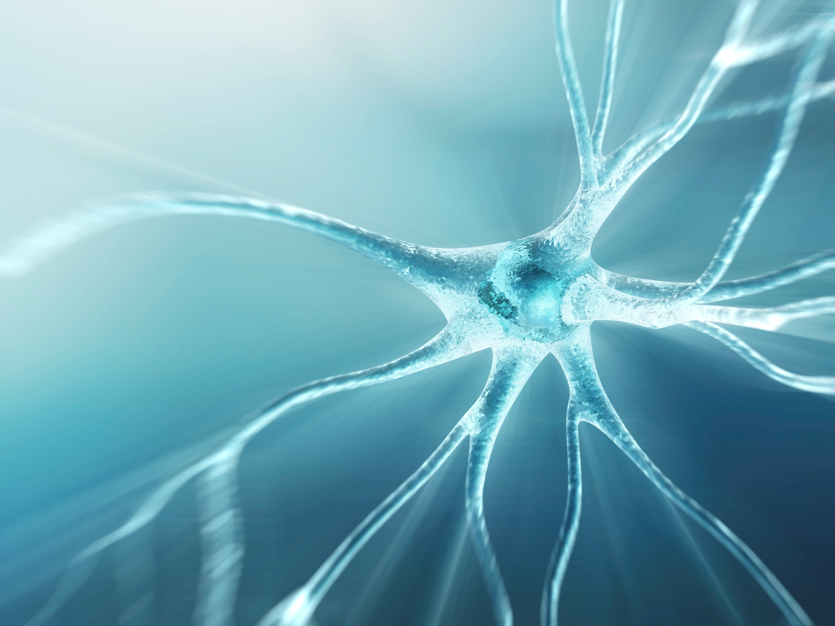
The factors which may cause this condition are as follows:
Conditions that cause nerve damage (neuropathy), such as diabetes, alcoholism and Guillain-Barre syndrome
Recognise and Promote Ways to Support Healthy Functioning of the Body

Slide 36
Fluid Balance and Electrolyte Balance
The kidneys are a pair of bean-shaped organs and are essential for regulating the fluid and electrolyte composition of the body.
The kidneys are responsible for maintaining fluid and electrolyte balance.
They go hand in hand, which is why failing to keep them at their ideal state would lead to various body systems failing to function at their normal capacity.
Electrolyte balance is all about the combined levels of the different electrolytes found in the blood.
Recognise and Promote Ways to Support Healthy Functioning of the Body

Slide 37
In older people, the factors that may affect the body’s ability to maintain fluid and electrolyte balance include:
What and how much you eat and drink
The level of functioning of the kidneys
Illnesses associated with ageing, e.g. diabetes, kidney stones, diabetes
Certain medications, e.g. prolonged use of over-the-counter pain medication
Recognise and Promote Ways to Support Healthy Functioning of the Body

Slide 38
The ways in how the kidneys maintain fluids and electrolyte and pH at 7.35 – 7.45, which is the normal pH level, may include:
The kidneys’ cells reabsorb bicarbonate HCO3− from the urine back to the blood, and they secrete hydrogen H+ ions into the urine.
By adjusting the amounts reabsorbed and secreted, they balance the bloodstream’s pH.
Recognise and Promote Ways to Support Healthy Functioning of the Body

Slide 39
Body Waste Elimination
The excretory system is a passive biological system that removes excess and unnecessary materials from the body so as to help maintain homeostasis and prevent damage.
Recognise and Promote Ways to Support Healthy Functioning of the Body

Slide 40
Several parts of the body are involved in this process, some include:
Skin
Secretes sweat
Lungs
Diffuses gaseous wastes from the bloodstream (e.g. carbon dioxide)
Recognise and Promote Ways to Support Healthy Functioning of the Body

Slide 41
Several parts of the body are involved in this process, some include:
Liver
Secretes sweat
Detoxifies the blood to remove toxins
Responsible for protein synthesis
Produces biochemicals necessary for digestion
Recognise and Promote Ways to Support Healthy Functioning of the Body

Slide 42
Several parts of the body are involved in this process, some include:
Kidneys
Filters and fluid metabolic waste (e.g. urine)
Small intestine
Processes and eliminates undigested food content and waste products
Colon
Where undigested food and waste products go before secreted from the body
Where water is reabsorbed before wastes are secreted from the body
Recognise and Promote Ways to Support Healthy Functioning of the Body

Slide 43
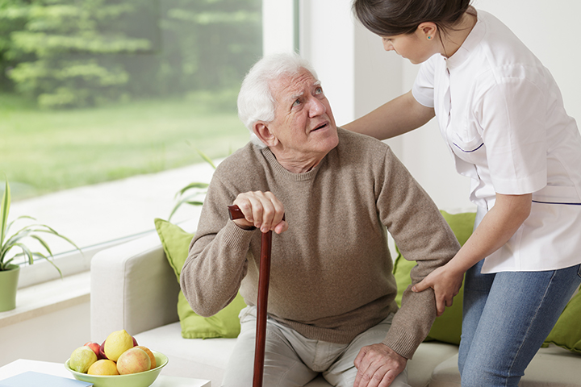
Older people find it more difficult to eliminate wastes from their body due to the changes in their body as they age and due to the various illnesses they have which directly affects the aforementioned parts of the body.
Recognise and Promote Ways to Support Healthy Functioning of the Body

Slide 44
Examples of conditions that may lead to respiratory acidosis include:
Asthma
Emphysema and chronic bronchitis
Pneumonia (severe)
Obesity
Sleep apnoea
Recognise and Promote Ways to Support Healthy Functioning of the Body

Slide 45
Blood pressure
Our body tries to stabilise blood pressure through the process of homeostasis.
The body must maintain blood pressure at its ideal range to avoid concerning conditions.
Recognise and Promote Ways to Support Healthy Functioning of the Body

Slide 46
To know the ideal range of a normal blood pressure, you must be familiar with systolic and diastolic pressure.
Pressure | Explanation
Systolic | The pressure of the blood during the heart contraction (systole).
Diastolic | The pressure of the blood when the heart is at rest between heartbeats (diastole).
Recognise and Promote Ways to Support Healthy Functioning of the Body

Slide 47

As people get older, they are more likely to have elevated blood pressure.
This is because blood vessels become stiffer as we age, which makes our blood pressure rise.
Recognise and Promote Ways to Support Healthy Functioning of the Body

Slide 48
The factors that can affect blood pressure include:
Cardiac output
Peripheral resistance
Resistance of arteries to blood flow
Blood pumped out of the heart in one minute
Blood viscosity
Thickness and stickiness of blood
Recognise and Promote Ways to Support Healthy Functioning of the Body

Slide 49
The table below shows the Blood Pressure Chart which can help you know the normal blood pressure range:
Blood Pressure Category | Systolic |  | Diastolic
Normal | Less than 120 | and | Less than 80
Prehypertension | 120-139 | or | 80-89
Stage 1 Hypertension (High blood pressure) | 140-159 | or | 90-99
Recognise and Promote Ways to Support Healthy Functioning of the Body

Slide 50
The table below shows the Blood Pressure Chart which can help you know the normal blood pressure range:
Blood Pressure Category | Systolic |  | Diastolic
Stage 2 Hypertension (High blood pressure) | 160 or higher | or | 100 or higher
Hypertensive Crisis (Emergency care needed) | Higher than 180 | or | Higher than 110
Recognise and Promote Ways to Support Healthy Functioning of the Body

Slide 51
2.2.2 Protection from Infection
Infection and sepsis are responsible for nearly one-third of all-cause mortalities in clients aged 65 years and over.
Nearly 90% of deaths from pneumonia are in this patient population.
Sepsis is associated with old age, and chronic complex comorbidities influence and increase risk.
Recognise and Promote Ways to Support Healthy Functioning of the Body

Slide 52
Common Infections
Infection | Description
Pneumococcal disease | Includes pneumonia, bronchitis, bacteraemia, and meningitis caused by any one of the 83 serotypes of Streptococcus pneumoniae
Influenza | Respiratory infection caused by any of the strains of the antigenically variable influenza A and B viruses
Nosocomial infections | Infections of any type that are not present on admission to a hospital but develop after the third hospital day
Recognise and Promote Ways to Support Healthy Functioning of the Body

Slide 53
Common Infections
Infection | Description
Tuberculosis | Can present as a pneumonia
Covid-19 | An infectious disease caused by the SARS-CoV-2 virus
Recognise and Promote Ways to Support Healthy Functioning of the Body

Slide 54
Infections are caused by the overgrowth of micro-organisms in the body (e.g. bacteria, viruses, and fungi).
Depending on the type of infection, treatments can differ.
Some are treated with antibiotics such as amoxicillin, erythromycin and ciprofloxacin.
Recognise and Promote Ways to Support Healthy Functioning of the Body

Slide 55

Signs of infection:
Fever
Feeling tired or fatigued
Swollen lymph nodes in the neck, armpits, or groin
Headache
Nausea or vomiting
Recognise and Promote Ways to Support Healthy Functioning of the Body

Slide 56
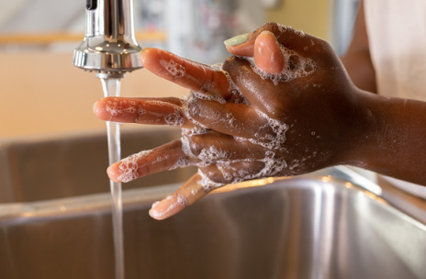
Ways to prevent infections
Most of your clients may already be immunocompromised due to their age.
This makes them susceptible to various diseases and infections.
Recognise and Promote Ways to Support Healthy Functioning of the Body

Slide 57
It is only right that you follow good infection control practices to avoid infecting elderly and disabled clients.
Stay away from the client when sick
Wash hands at regular intervals
Clean thoroughly
Wear protective equipment
Recognise and Promote Ways to Support Healthy Functioning of the Body

Slide 58

For maintaining proper hygiene, cleaning and washing are essential things to consider.
A clean surrounding is less likely to be contaminated.
Put all disinfecting wipes, toilet seat sanitisers, and other cleaning supplies to clean every room efficiently.
Recognise and Promote Ways to Support Healthy Functioning of the Body

Slide 59
Some high contact places which need utmost attention and cleaning are:
Doorknobs
Handles
Taps
Light switches
Countertops
Faucets and toilets
Recognise and Promote Ways to Support Healthy Functioning of the Body

Slide 60
2.2.3 Physical Activities
Adults aged 65 years and above, with the advice of a health professional, should do at least 150 minutes of moderate-intensity physical activity or at least 75 minutes of vigorous-intensity physical activity throughout the week.
People with mobility challenges should perform physical activity to enhance balance and prevent falls, three or more days per week.
People with disability or chronic conditions are also recommended to try and meet the physical recommendations for their age groups.
Recognise and Promote Ways to Support Healthy Functioning of the Body

Slide 61
There are two types of exercises that your client can do to keep their bodies healthy depending on their situation:
Active exercise
Performed by the client with volitional control
Passive exercise
Performed without volitional control
Recognise and Promote Ways to Support Healthy Functioning of the Body

Slide 62

Active exercises are normally for clients with physical capability to perform active exercises while passive exercise are normally for clients who may be stroke survivors left with mild to severe paralysis.
Recognise and Promote Ways to Support Healthy Functioning of the Body

Slide 63
Examples of passive exercises include:
Passive range of motion (ROM) exercises
Functional neuromuscular stimulation (FNS)
Facilitated electrical stimulated (FES) exercise
Technician-assisted exercise
Use of leg extension or leg-cycling equipment
Hydrotherapy or swim in a warm pool
Recognise and Promote Ways to Support Healthy Functioning of the Body

Slide 64
Just a slight increase in activity each day can improve your health and wellbeing. It can help:
Reduce the risk of health issues
Maintain a healthy weight
Reduce the risk of falls and injury
Give more energy
Improve sleep
Reduce stress and anxiety
Recognise and Promote Ways to Support Healthy Functioning of the Body

Slide 65

2.3
Share Information About Healthy Body Functioning

Slide 66
In your workplace, you commonly share information with your colleagues.
It is possible that there are two or more of you who work with one client.
Carrying out work tasks can sometimes mean working with multidisciplinary health teams.
A multidisciplinary health team is composed of different health professionals that have their own fields of specialisation. They can also be addressed as allied health team or allied health care.
Recognise and Promote Ways to Support Healthy Functioning of the Body

Slide 67
Below are some examples of people who are part of the multidisciplinary health teams you can work with, especially when implementing a client’s individualised plan.
Multidisciplinary health team specialist | Possible role in providing service delivery
Physical therapists | Improve or restore physical functioning, such as strength or movement.
Occupational therapists | Improve client’s ability to perform tasks associated with daily living.
Speech pathologists | Improve or restore speech of clients who have had illnesses that affected their speech.
Recognise and Promote Ways to Support Healthy Functioning of the Body

Slide 68
Below are some examples of people who are part of the multidisciplinary health teams you can work with, especially when implementing a client’s individualised plan.
Multidisciplinary health team specialist | Possible role in providing service delivery
Respiratory therapist | Assess and treat patients who are having difficulty breathing.
Recreational therapist | Evaluate the patient to determine the patient’s needs and what types of activities the patient enjoys.
Clinical nutritionists | Work with individual patients to ensure they get proper nutrition based on their medical condition.
Recognise and Promote Ways to Support Healthy Functioning of the Body

Slide 69
Below are some examples of people who are part of the multidisciplinary health teams you can work with, especially when implementing a client’s individualised plan.
Multidisciplinary health team specialist | Possible role in providing service delivery
Chaplain services | Hospital chaplains can help patients deal with the stress of being hospitalised through counselling and prayer.
Rehabilitation counsellors | Rehabilitation counsellors provide assistance following the onset of illness or injury and for people with life-long, acquired or developing disability.
Recognise and Promote Ways to Support Healthy Functioning of the Body

Slide 70
Below are some examples of people who are part of the multidisciplinary health teams you can work with, especially when implementing a client’s individualised plan.
Multidisciplinary health team specialist | Possible role in providing service delivery
Pharmacists | They provide advice on how to use medicine safely.
Social workers | They provide counselling, information and referrals to other services.
Recognise and Promote Ways to Support Healthy Functioning of the Body

Slide 71
Below are the steps to follow when working with allied health professionals to implement individualised plans.
Review the client’s individualised care
Seek the client’s doctor’s referral
Reach out to an allied health professional
Implement service delivery according to the help of an allied health professional
Recognise and Promote Ways to Support Healthy Functioning of the Body

Slide 72
Below lists the procedures to be followed for coordinating with allied professionals that you can use:
When support services and activities require tasks that are outside the scope of the support worker's role, knowledge and expertise, these services and activities may be sourced outside the organisation.
Before availing of the services of a health professional, check that they are a registered and/or accredited member of his profession by checking the Australian Health Practitioner Regulation Agency register of practitioners.
Recognise and Promote Ways to Support Healthy Functioning of the Body

Slide 73

Below lists the procedures for coordinating with allied professionals that you can use:
Check that outsourced services and activities come from a registered business with a reputable business record.
Recognise and Promote Ways to Support Healthy Functioning of the Body

Slide 74

Below lists the procedures for coordinating with allied professionals that you can use:
The following personnel and services must be consulted for concerns indicated:
Physiotherapist - clients in need of physical therapy
Psychologist - clients with mental health problems
Recognise and Promote Ways to Support Healthy Functioning of the Body

Slide 75
Below lists the procedures for coordinating with allied professionals that you can use:
The following personnel and services must be consulted for the concerns indicated below:
Meals on Wheels - for clients who would like to avail of meal delivery services
National Auslan Booking and Payment Service - for people with hearing impairment who need interpreters for their medical appointments
Recognise and Promote Ways to Support Healthy Functioning of the Body

Slide 76

Below lists the procedures for coordinating with allied professionals that you can use:
Support workers may ask their supervisor for references to other health professionals and service providers who may help them deliver support to clients.
Recognise and Promote Ways to Support Healthy Functioning of the Body

Slide 77
Escalating Concerns
Should there be changes in the client’s status, such as worsening or improvement of the condition, reaction to medications and additional treatment requests, you have to relay this to the responsible allied health professional.
Recognise and Promote Ways to Support Healthy Functioning of the Body

Slide 78
Escalating Concerns
Below are examples of the concerns that need escalation:
Vomiting after receiving medicines
Refusal to take medications or other treatment
Slower body movement
Decreased appetite
Bruises in the body
Fever
Recognise and Promote Ways to Support Healthy Functioning of the Body

Slide 79
Escalating Concerns
During your shift, reflect this on the client’s chart or progress notes so that other health professionals can check this during their shift. Ensure that your notes are detailed and accurate. Here is some important information that you can include in your notes:
What is the specific concern or change
Signs or manifestations observed
Immediate action implemented (if there is any)
Recognise and Promote Ways to Support Healthy Functioning of the Body

Slide 80
Escalating Concerns
During your shift, reflect this on the client’s chart or progress notes so that other health professionals can check this during their shift. Ensure that your notes are detailed and accurate. Here is some important information that you can include in your notes:
Changes that are part of the individualised plan
Concerned health professional/s that needs to attend to the concern or changes
Recognise and Promote Ways to Support Healthy Functioning of the Body

Slide 81

2.4
Identify and Report Changes in the Person’s Health Status

Slide 82
As a support worker, it is important to stay up to date with the client’s status.
This way, it will be easier for you to recognise if there are changes. If there are changes, they should be documented and reported immediately to your supervisor or concerning allied health professional.
Recognise and Promote Ways to Support Healthy Functioning of the Body

Slide 83
2.4.1 Changes in the Client’s Health Status and Physical Condition
Although the changes you might observe vary per client, the samples below can give you an idea of what these changes might be.
Decrease in appetite or food and water intake
Easily gets tired
Trouble sleeping (longer or shorter hours of sleep than usual)
Trouble speaking
Not being able to control pee or bowel movement
Blank facial expressions
Recognise and Promote Ways to Support Healthy Functioning of the Body

Slide 84
Although the changes you might observe vary per client, the samples below can give you an idea of what these changes might be.
Bruises in the body
Easily forgetting things
Decrease interest in the activities they used to enjoy
Pain in some body parts
More energy in doing daily activities
Increase in appetite
Recognise and Promote Ways to Support Healthy Functioning of the Body

Slide 85
Recognising Changes in the Client’s Status
Despite the differences, below are general steps you can follow to check for changes in the client’s health status and physical condition. These are as follows:
Regularly check the client’s care chart or progress notes.
Regularly check your client’s physical body.
Talk to your client and ask them to share what they feel.
Recognise and Promote Ways to Support Healthy Functioning of the Body

Slide 86
Completing Reports According to Organisational Policies and Procedures
As a care worker, examples of reports you may encounter include the following:
Progress reports
Incident reports
Critical incident reports
Mandatory reports
Recognise and Promote Ways to Support Healthy Functioning of the Body

Slide 87
Completing Reports According to Organisational Policies and Procedures
Reports can be physically written or typewritten in their digitalised format. Regardless of its form, you need to prepare the report with the following in mind:
Accuracy
Objectivity
Essential details
Recognise and Promote Ways to Support Healthy Functioning of the Body

Slide 88
2.4.2 Reporting to Supervisor or Health Professional
Any observed or reported changes in the client’s health status and physical condition must be reported to your supervisor or concerned health professional.
This is to ensure that they can address the changes properly and immediately. Reporting the client’s condition is also part of your compliance with your organisation’s policy.
Recognise and Promote Ways to Support Healthy Functioning of the Body

Slide 89
In reporting changes, remember these things:
The hierarchical organisation for reporting and what kind of changes to report
Identify if the change/s need to be addressed immediately.
If the changes are critical, immediately report it to the concerned person.
If the changes are not critical, you may update the record first before reporting verbally to your supervisor or concerned health professional.
Recognise and Promote Ways to Support Healthy Functioning of the Body

Slide 90
In reporting changes, remember these things:
Regularly update the progress notes or client’s records as soon as possible and before the day ends
If your supervisor holds a one-on-one or team daily or weekly report, prepare the client’s updated record and hand it over.
Recognise and Promote Ways to Support Healthy Functioning of the Body

Slide 91

What have we learnt?
In this part of the session, we have covered:
Work with information about the human body
Recognise and promote ways to support healthy functioning of the body

Slide 92
End of Chapter 2

Slide 93

Presentation Objectives
Now that you have completed this presentation, you should be able to:
Work with information about the human body
Recognise and promote ways to support healthy functioning of the body

Slide 94
End of CHCCCS041 Presentation

Slide 95
Version Control & Document History
Date | Summary of Modifications | Version
13 January 2023 | Version 1.0 released for publishing | 1.0
14 April 2023 | Version 1.1 endorsed for use Minor revisions for improved readability | 1.1
22 August 2023 | Version 1.2 endorsed for use Fixed wording issues | 1.2

